Slide 1

AI-Based Smart Irrigation Scheduling using BiRNN & BiLSTM
Presented by
Presented to
(103123022) CH. Koushik Rao
(103123124) Vrindesh Pareek
(103123066) K. Manish Kumar
Dr. S. Saravanan
Professor, Dept. of Civil Engg
Department of Civil Engineering,
NIT Tiruchirappalli – 620015
Date: 10-04-2026
CEPC22 – Hydrology & Irrigation Engineering

Slide 2
INTRODUCTION
The Problem We Are Solving
🌡️ Rising Temperatures
🌧️ Erratic Rainfall
Annual temp in Karnal rising at +0.03°C/yr causeshigher ET₀ and more water needed per crop cycle
Monsoon becoming shorter but intense creating soil moisture uncertainty causing irrigation timing failure
💧 Fixed Schedules
🤖 Our Solution
Farmers use 50-year-old irrigation calendars leading to 30–40% water wastage or crop stress
AI-powered daily irrigation prediction using BiLSTM deep learning + climate change forecasting

Slide 3
OBJECTIVES
Project Objectives
Compute ET₀
Soil Moisture
Train BiRNN
01
FAO-56 Penman-Monteith evapotranspiration for Karnal
02
Daily water balance model (FC=150mm, WP=60mm)
03
Bidirectional RNN baseline model with Bayesian tuning
Train BiLSTM
Compare & Select
Schedule 2026–2040
04
Bidirectional LSTM advanced model — best temporal memory
05
Auto-select winner based on RMSE, MAE, NSE, R²
06
Season-wise irrigation calendar for Wheat & Rice

Slide 4
STUDY AREA & DATA
Karnal, Haryana — Study Area & NASA POWER Data
📍 Karnal, Haryana, India
NASA POWER Variables (2011–2025)
Latitude: 29.6°N
T2M
Temperature at 2m
°C
Longitude: 76.9°E
PRECTOTCORR
Corrected Rainfall
mm/d
Elevation: 237.6 m (MERRA-2)
Climate: Semi-arid
RH2M
Relative Humidity
%
Soil: Loamy (Indo-Gangetic)
WS2M
Wind Speed at 2m
m/s
Max Temp: 41°C (May–Jun)
ALLSKY_SFC_SW_DWN
Solar Radiation
MJ/m²/d
Min Temp: 7°C (Jan)
Avg Rain: ~750 mm/year
5,479 daily records | 15 Years | Zero missing values after QC

Slide 5
METHODOLOGY
Project Methodology Pipeline
1
NASA POWER
Data (5479 days)
2
Data Cleaning
& QC
3
FAO-56
ET₀ + SMS
4
Feature Eng.
(19 features)
5
Bayesian
Hyper-Tuning
6
BiRNN vs
BiLSTM Train
11
Output CSVs
+ Report
10
Rabi + Kharif
Calendar
9
Irrigation
Schedule
8
Future Forecast
2026–2040
7
Auto Model
Selection

Slide 6
THEORETICAL BACKGROUND
FAO-56 Penman-Monteith ET₀ & Soil Moisture Balance
ET₀ = [ 0.408·Δ·(Rn−G)+γ·(900/(T+273))·u₂·(es−ea) ] /
[ Δ + γ·(1+0.34·u₂) ]
Rn
Net radiation (MJ/m²/d)
T
Temperature (°C)
u₂
Wind speed (m/s)
es−ea
Vapour pressure deficit
Δ
Slope of sat. VP curve
γ
Psychrometric constant
Soil Moisture Balance: SMS(t) = SMS(t−1) + P(t) − ET₀(t) − IR(t) → Clipped to [WP=60mm, FC=150mm]
Irrigation Requirement:
IR = max(0, ETc − P_eff)
where ETc = Kc × ET₀
Crop Coefficients (Kc):
Wheat Rabi peak: Kc = 1.15 (Dec–Feb)
Rice Kharif peak: Kc = 1.20 (Aug–Sep)

Slide 7
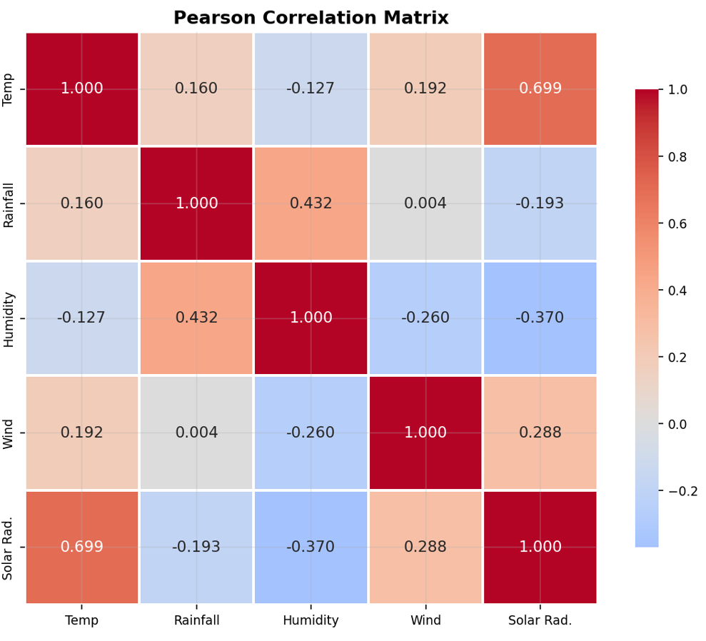
EXPLORATORY DATA ANALYSIS (EDA)

Slide 8
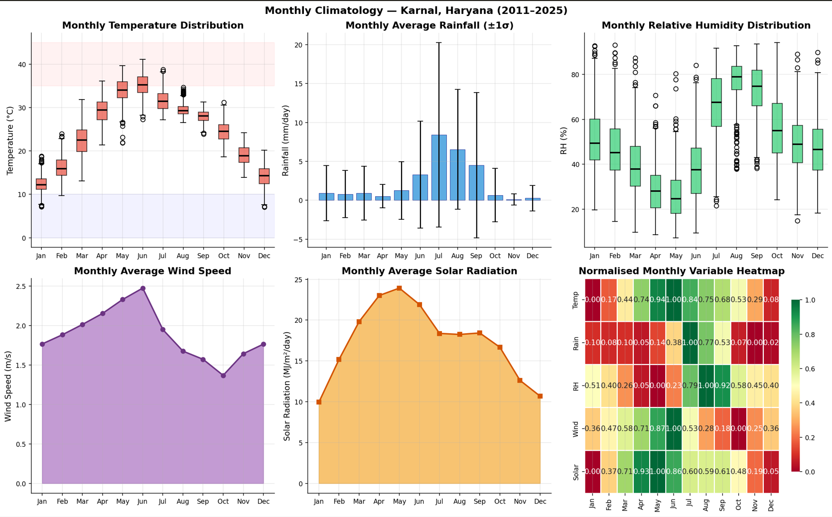
THEORETICAL BACKGROUND
FAO-56 Penman-Monteith ET₀ & Soil Moisture Balance

Slide 9
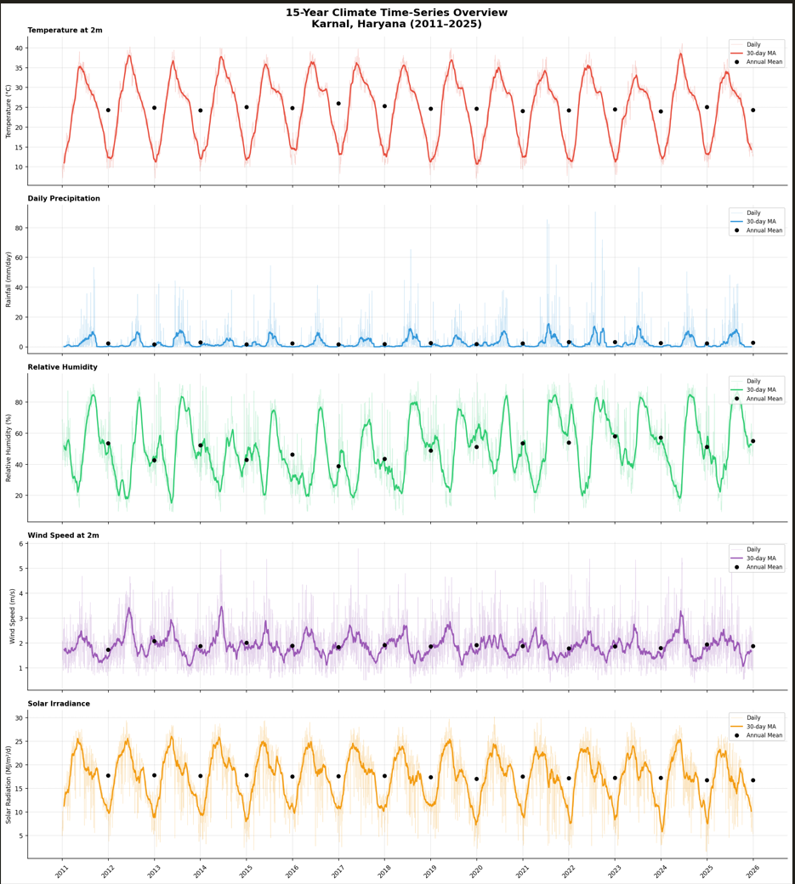
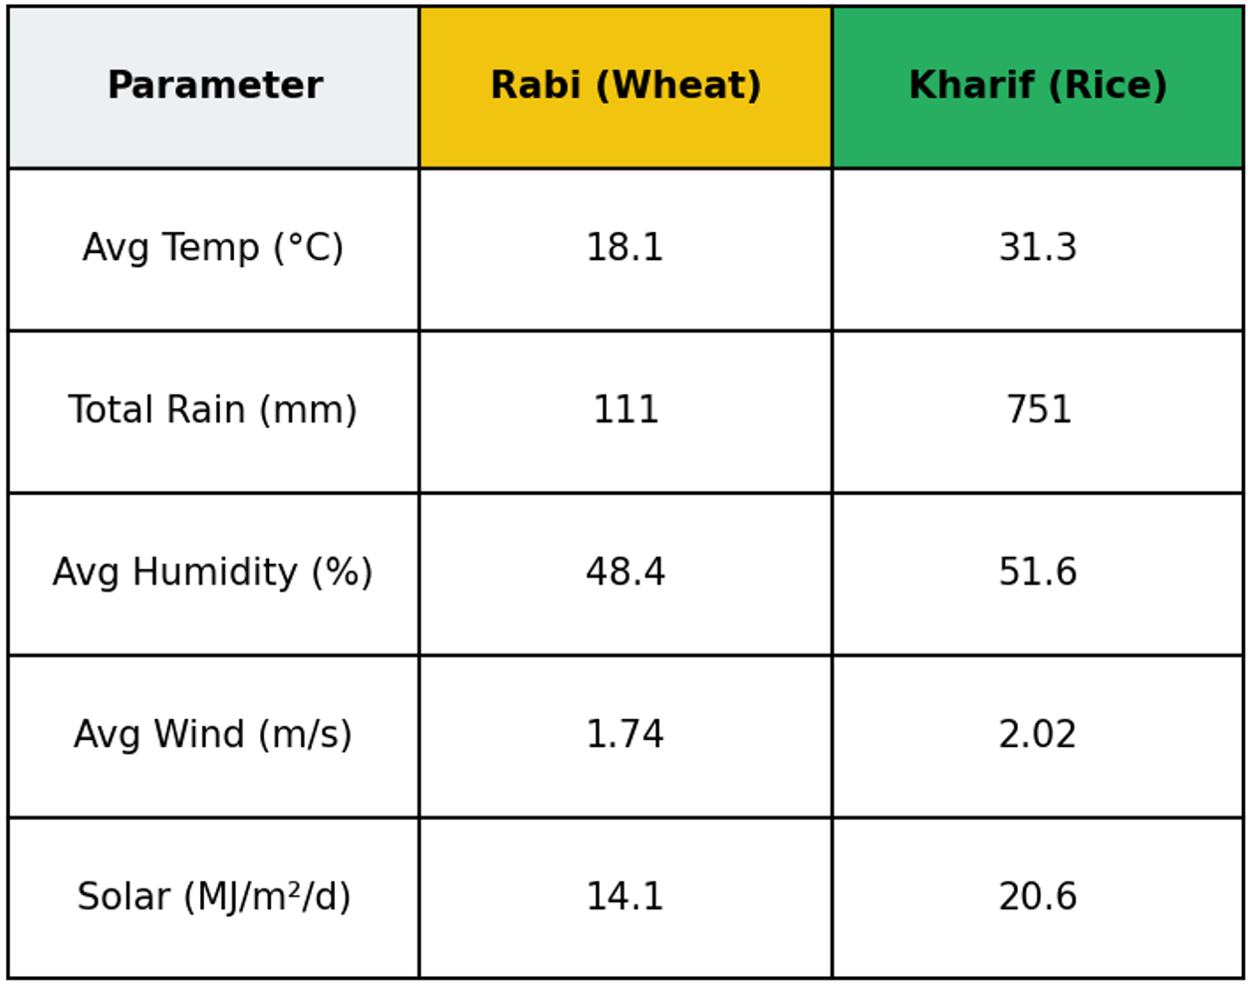
15 Year Climate Overview (2011-2025)

Slide 10
DEEP LEARNING MODELS
BiRNN vs BiLSTM — Architecture Comparison
BiRNN — Baseline
BiLSTM — Advanced 🏆
Input: (14 time steps × 19 features)
Input: (14 time steps × 19 features)
→ Bidirectional SimpleRNN (tuned units)
→ Bidirectional LSTM (tuned units)
→ Dropout + BatchNorm (optional)
→ Dropout + BatchNorm (optional)
→ Bidirectional SimpleRNN (tuned units)
VS
→ Bidirectional LSTM (tuned units)
→ Dropout
→ Dropout
→ Dense(16, ReLU)
→ Dense(32, ReLU) → Dense(16, ReLU)
→ Dense(1) — Irrigation (mm/day)
→ Dense(1) — Irrigation (mm/day)

Slide 11
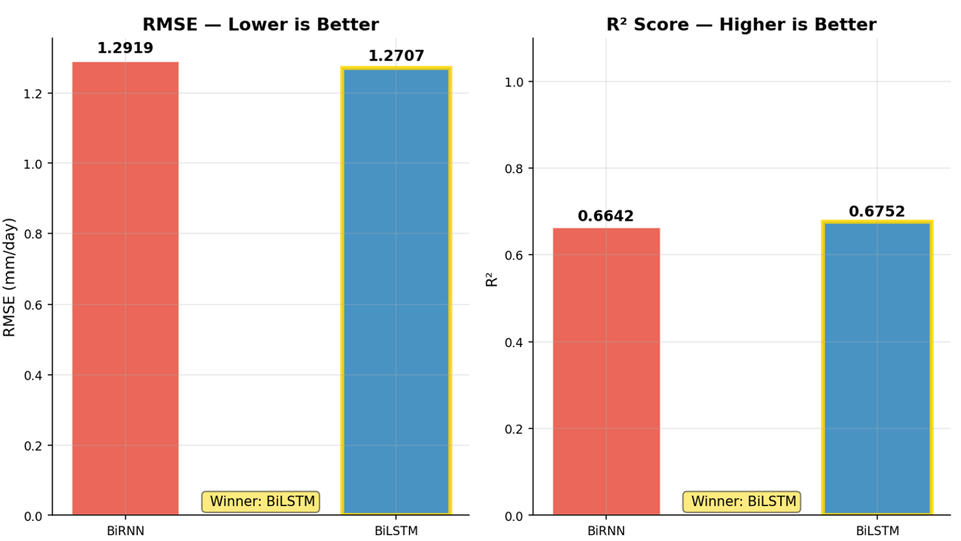
Model Selection Based on Performance Comparison
BiRNN vs BiLSTM – Performance Metrics Comparision

Slide 12
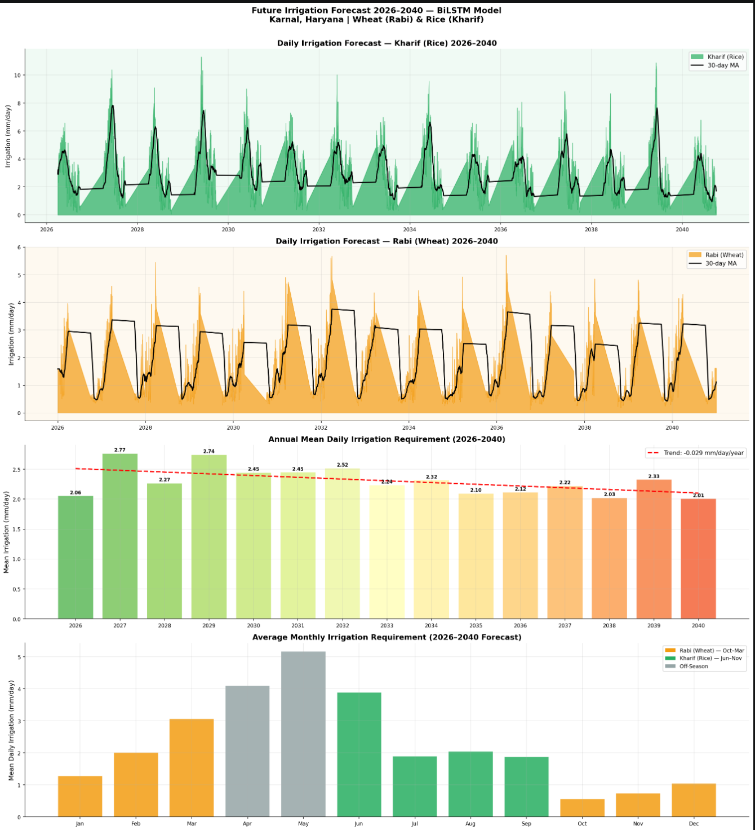
FUTURE FORECAST 2026–2040
Climate Change Irrigation Forecast — 2026 to 2040
Key Finding: Irrigation demand projected to increase 8–15% for Rabi (Wheat) and show higher variability for Kharif (Rice) by 2040

Slide 13
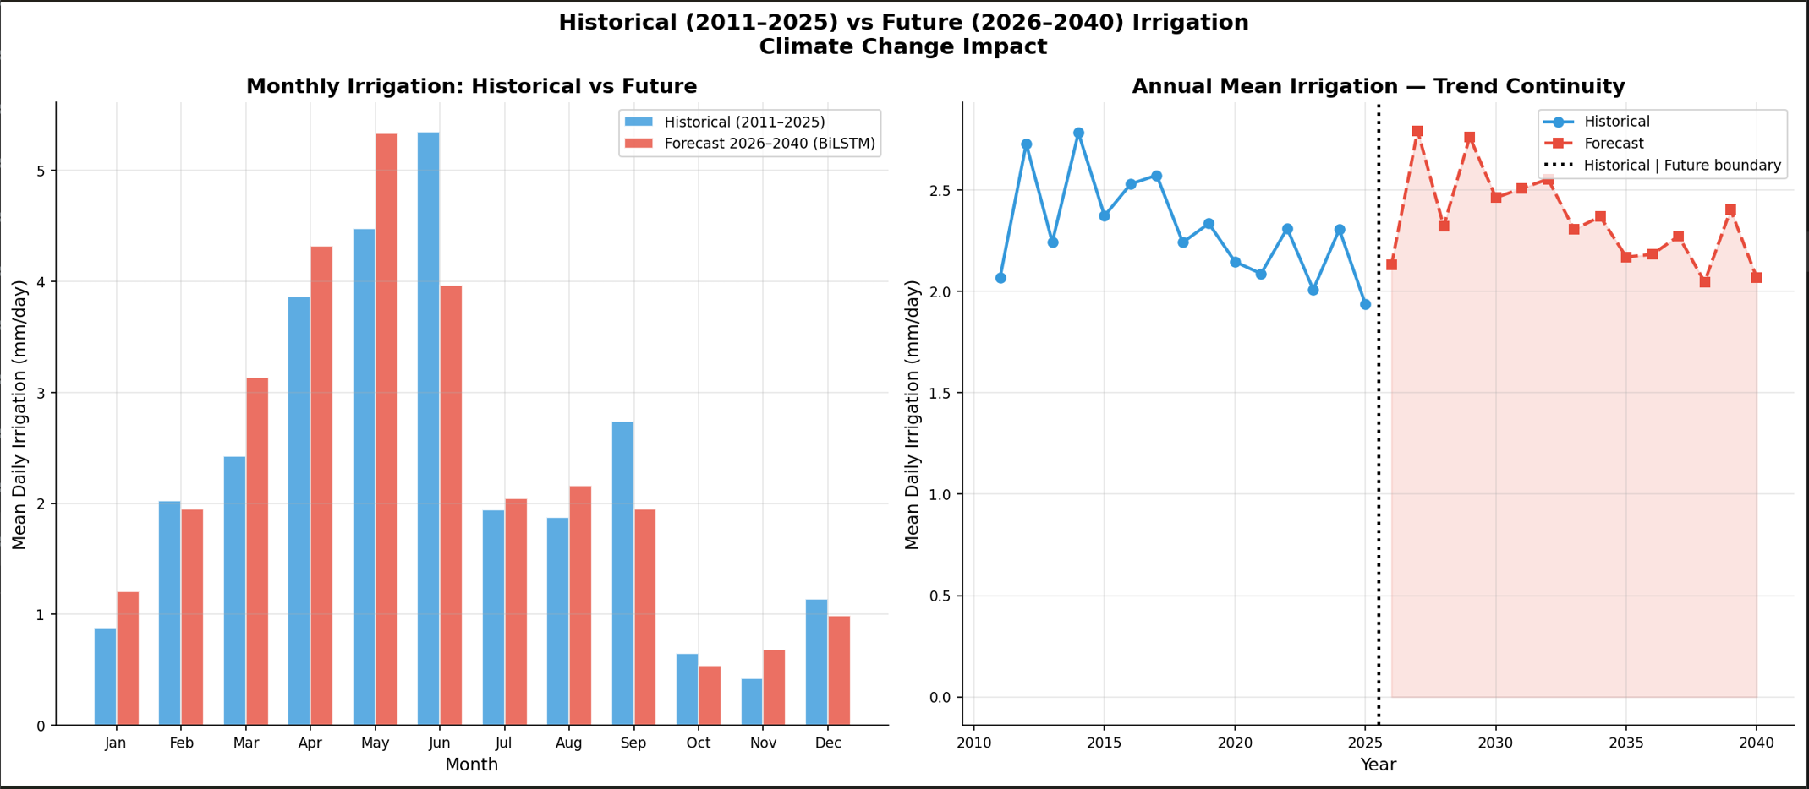
Hystorical vs Future Monthly and Annual mean Irrigation
Climate Change Irrigation Forecast — 2026 to 2040

Slide 14
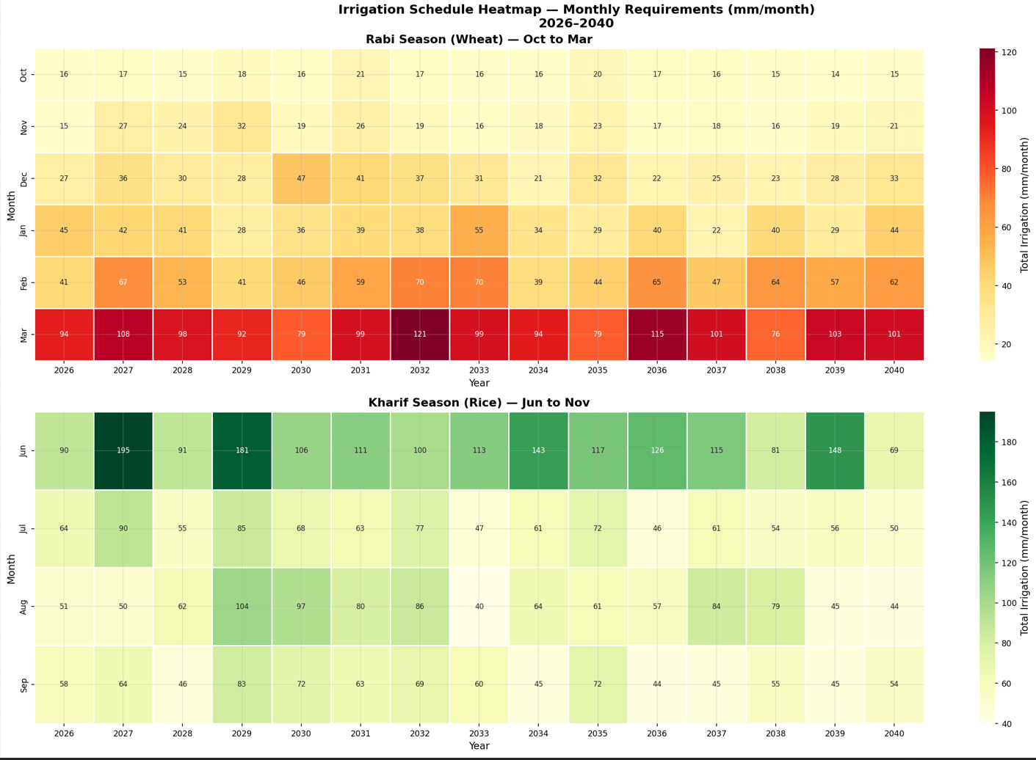
Monthly Forecasted Irrigation Requirement (mm/month)

Slide 15
IRRIGATION SCHEDULING
Season-Wise Irrigation Scheduling Calendar
🌾 Rabi Season — Wheat
🌾 Kharif Season — Rice
October
Initial stage (Kc=0.30)
Skip / light irrigation
June
Nursery–Transplant (Kc=1.05)
Daily/every 2 days ⚠️
November
Germination
Every 7–10 days
July
Vegetative growth
Every 2–3 days
December
Tillering (Kc=1.15)
Every 3–4 days ⚠️
August
Tillering (Kc=1.20)
Every 2 days ⚠️
January
Jointing–Booting
Every 3–4 days ⚠️
September
Heading–Flowering
Critical — monitor daily
February
Grain filling
Every 4–5 days
October
Grain filling (Kc=0.80)
Every 5–7 days
March
Maturity (Kc=0.75)
Every 7 days
November
Maturity–Harvest
Stop irrigation

Slide 16
CLIMATE CHANGE IMPACT
Climate Change Impact on Irrigation Water Demand
Why ML Fails Here
Why BiLSTM Wins
ML models assume statistical independence of samples. Irrigation demand has temporal memory — a drought 2 weeks ago affects soil moisture today. Simple models cannot capture this.
BiLSTM gates retain cumulative climate effects. The forget gate discards irrelevant past, input gate stores new stress signals, output gate controls what influences prediction.
Rabi Impact by 2040
Kharif Impact by 2040
Temperature rise → ET₀ +3–5%
Irrigation demand +8–12%
December most critical month
Groundwater stress increases
Monsoon variability increases
Dry spell irrigation +15–20%
August–September most affected
Adaptive scheduling critical

Slide 17
OUTPUTS
Project Deliverables & Output Files
01
Historical Dataset Processed
5,479 rows with ET₀, ETc, SMS, Irrigation, VPD
02
Model Performance Metrics
BiRNN vs BiLSTM — RMSE, MAE, R², NSE, MAPE
03
Test Set Predictions
Actual vs BiRNN vs BiLSTM — daily test period
04
Future Forecast Daily
5,479 daily predictions (2026–2040) + soil moisture
05
Rabi Irrigation Schedule
Monthly wheat schedule with advisory (2026–2040)
06
Kharif Irrigation Schedule
Monthly rice schedule with advisory (2026–2040)
07
Best Hyperparameters
Tuned HP values for BiRNN and BiLSTM models

Slide 18
THANK YOU

